Slide 1
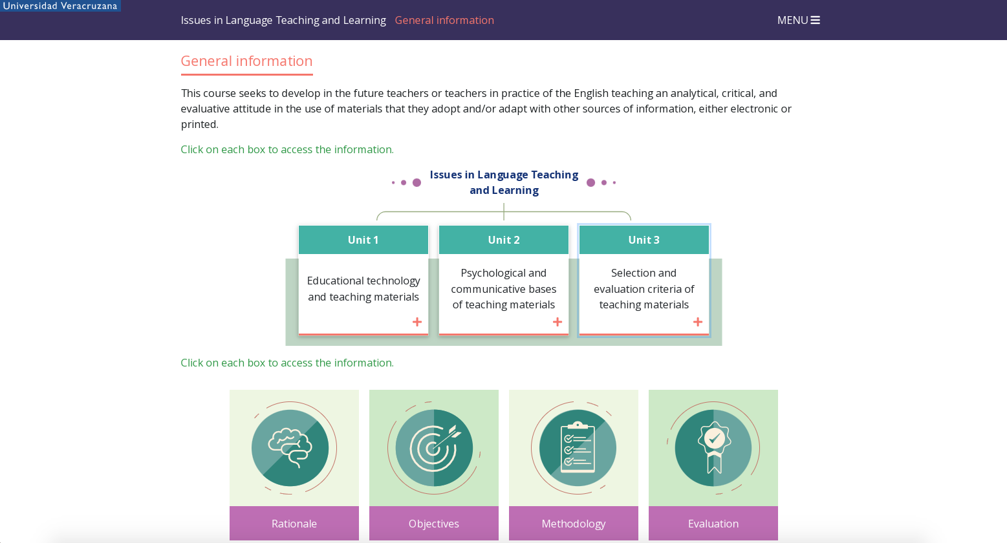
DG/P:
Información para introducción de Unit 1.
Escritorio
Recurso de modales.
Realizar diseño para modales, sin separar el botón de la imagen.
Información en siguiente diapositiva.
Dispositivos
Texto plano.
English Proficiency
HTML Outline:
English Proficiency
Unit 1. Grammar and Use of English
Introduction
Objectives
Contents
Evaluation
Unit 1. Grammar and Use of English
Introduction
This unit provides an overview of the notions of communicative competence, language proficiency and the Common European Framework of Reference for Languages.
It also introduces us to the Certificate of Advanced English exam (or C1 Advanced exam) and we will start to work on practice tests in preparation for the final exam. The first paper we will concentrate on in detail is use of English, by looking at a series of grammar constructs and pitfalls.
Instructions: Click on the bottons below to read the information.
Img
Img
Img
Objectives
Contents
Evaluation

Slide 2
Objectives
By the end of this unit, students will:
Be familiar with the concepts of communicative competence, language proficiency and the principles of CEFR for C1 level.
Be familiar with the level of English used in CAE preparation texts.
Be able to recognize and use a series of grammar constructs.
Be able to identify and remedy the use of false cognates.
Engage in critical reading and writing practice using an authentic text.
Contents
Communicative competence.
Communicative competence, language proficiency and the CEFR.
CEFR descriptors for the C1 level and the C1 Advanced Exam.
Grammar.
A degree of modification.
Suffixes.
Collocations.
False friends.
Dependent prepositions.
Gerund or infinitive?
Evaluation
This unit contains plenty of online grammar practice, which you will be doing as part of the self-access element of the course. To be assessed in this unit, you also have to complete a series of use of English papers from the CAE exam, perform a critical reading and writing exercise using examples of the grammar points seen, and finally, engage in active and on-going participation of forums which provide central discussion in this course. Remember to download and save your activities and to include them in your Unit 1 portfolio.

Slide 3
DG/P:
Información Tema 1.1
Escritorio
Diseño para actividad 01.
Archivo en PDF en Teams (no se modifica).
PDF file(nombre del archivo)- Button.
Dispositivos
Se queda igual.
English Proficiency
HTML Outline:
English Proficiency
1.1 Communicative competence, language proficiency and the CEFR
Communicative competence
  Activity 01
Communicative competence, language proficiency and the CEFR
  Activity 02
1.1 Communicative competence, language proficiency and the CEFR
Communicative competence
Before we start work on tasks to help you develop a C1 proficiency level, we will go over and reflect on some important notions that are the foundations for this course.
EP U1 Activity 01
What is communicative competence?
Instructions
In the following file, you will find an article on the notion of communicative competence and its evolution over the years.
Read the article and identify the five different models of communicative competence.
Create a mind map for each communicative competence model (one for Hymes (1972), one for Canale & Swain (1983), one for Bachman (1996/2010) one for Celce-Murcia, et al. (1995) and one for Palikowska-Smith (2002).
Notice the years, since some of the authors proposed more than one version of the model, but you should only create a mind map corresponding to the year indicated in number 2.
You can create your mind maps by hand (and upload them as .jpg or .png files) or with the aid of a PowerPoint or a mind map generator (like Canva or any other app that you know how to use and upload them as PDF, .jpg, .png or link).
Once you finish this activity, save the mind maps as one single file, name it EPU1_01_FirstNameandLastName.pdf, and include it in your Unit 1 portfolio for subsequent submission.
State of the art of communicative competence theory

Slide 4
DG/P:
Información Tema 1.1
Escritorio
Imagen de apoyo (sr-only) support image.
Recurso de faqs. Información en siguiente diapositiva.
Dispositivos
Los extractos cambian a archivo de descarga.
English Proficiency
Communicative competence, language proficiency and the CEFR
Now that you have an idea of the elements considered in communicative competence by different theoreticians over the years, the next step is to find the differences and commonalities between this notion and the concept of language proficiency and their relationship with the CEFR.
Read the following extracts about the main relationship between communicative competence and language proficiency from Ingram & Elaine Wylie (1992) and Spolsky (1989).
Instructions: Click on the bottons below to read the information.
Img
+ Extract 1
+ Extract 2

Slide 5
Información para faqs
Extract 1
"Language proficiency" refers to a learner's ability to mobilise the language in order to carry out language tasks; the term "communicative competence" is used both rigorously in ways that differ little from language proficiency and loosely to mean the ability to communicate. The important distinction between proficiency and communicative competence in its loose sense is illustrated by Sollenberger:
The person's so-called language proficiency, while it may have been quite accurate in technical skill terms, did not mean effectiveness in communication. In some cases, it may have enabled the person to misrepresent or foul up more effectively... I'm sure we all know people who talk nonsense fluently. On the other hand, I know people who butcher the language, whose accents are atrocious and whose vocabularies are limited. For these reasons we give them a low proficiency rating. Yet, for some reason, some of them are effective communicators.
In this loose sense, communicative competence is a desirable target for language teaching but poses immense problems for language testing. The ability to communicate is clearly a legitimate interest of language teachers and much language teaching is aimed at providing the linguistic knowledge and skills that contribute to this ability. However, the ability to communicate entails much more than linguistic competence (knowledge of the formal systems that underlie a language) and language proficiency (the ability to use linguistic and other competences in order to carry out language tasks) and includes personality factors such as introversion and extroversion, intelligence, the ability to organise and present ideas logically and comprehensibly, experience, education, social norms, and the willingness of the interlocutor to accommodate a learner's nonstandard language forms. Many of these variables are beyond a learner's control; indeed, some go well beyond language, and it is for these reasons that communicative competence in this loose sense is not a legitimate target for language testing. In fact, it is unlikely that a valid and reliable test of communicative competence in the sense of the ability to communicate is possible.
Language proficiency, by contrast, is a desirable target for language teaching and for language testing”. (Ingram & Elaine Wylie, 1992, p. 32).
Extract 2
“The relevance of a theory of communicative competence to language testing is obvious. Language tests involve measuring a subject's knowledge of, and proficiency in, the use of a language. A theory of communicative competence is a theory of the nature of such knowledge and proficiency. One cannot develop sound language tests without a method of defining what it means to know a language, for until you have decided what you are measuring, you cannot claim to have measured it: fundamental to the preparation of valid tests of language proficiency is a theoretical question: What does it mean to know a language?” (Spolsky et al., 1989, p. 140).

Slide 6
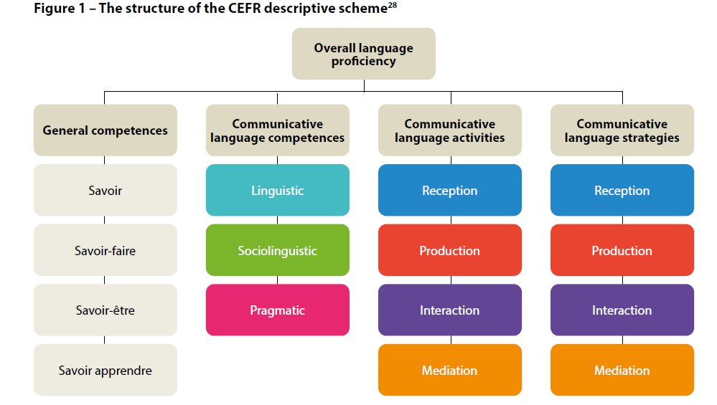
DG/P:
Información Tema 1.1
Escritorio
Diseño para actividad 02.
Rediseñar la imagen del mapa para que pueda leerla el lector.
Archivo en word en Teams. Requiere formato, el esquema, pleca de la EE.
Para el lector (sr-only):
Word document (nombre del archivo) – Button.
Dispositivos
Se quita paso 1 con esquema.
Paso 2 se vuelva 1.
Paso 3 se vuelve 2.
English Proficiency
EP U1 Activity 02
How do the concepts of communicative competence and language proficiency relate to the CEFRL?
Instructions
1. Observe the CEFRL language proficiency scheme below.
2. Identify the elements from communicative competence you revised in Activity EP U1 Activity 01. Answer the questions in the following format.
3. Once you finish this activity, save the mind maps as one single file, name it EPU1_02_FirstNameandLastName.pdf, and include it in your Unit 1 portfolio for subsequent submission.
Texto typeado:
Overall language proficiency
General competences
Savoir
Savoir-faire
Savoir-êntre
Savoir apprendre
Communicative language competences
Linguistic
Sociolinguistic
Pragmatic
Communicative language activities
Reception
Production
Interaction
Mediation
Communicative language strategies
Reception
Production
Interaction
Mediation
EP U1 Activity 02

Slide 7
DG/P:
Información Tema 1.2
Escritorio
Diseño para información.
El primer y tercer archivo adjunto en Teams.
Para el lector:
PDF file(nombre del archivo)- Button.
El segundo archivo (sr-only)
(nombre del archivo) opens a new tab.
https://www.cambridgeenglish.org/exams-and-tests/advanced/exam-format/
Para descarga (sr-only) word document.
Dispositivos
Texto y luego botón.
English Proficiency
HTML Outline:
English Proficiency
1.2 CEFR descriptors for the C1 level and the C1 Advanced Exam
CEFR descriptors for the C1 level
1.2 CEFR descriptors for the C1 level and the C1 Advanced Exam
CEFR descriptors for the C1 level
Read the next file and as you go over the descriptors, reflect on your own language proficiency.
CERF descriptors for C1
Having taken a practice FCE exam, you are now familiar with the format of Cambridge English tests: just as FCE, a Cambridge English: Advanced Exam (CAE before 2015) inclused papers on use of English, reading, writing, listening and speaking. Since changes made in 2015, the use of English and reading papers have been combined. You can find out more about the exam format.
C1 Advanced exam format.
You may also be interested in looking at the Cambridge English: Advanced handbook for teachers.
Cambridge English Qualifications
The first section (p. 2-6, Cambridge English Qualifications) provides a general introduction to the exam, while the later sections look at the different papers in more detail.
For the purpose of this course, we will look at use of English and reading separately, as they can be considered as different aspects of language.

Slide 8
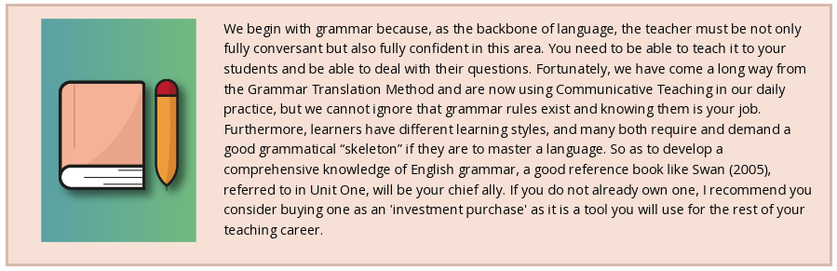
DG/P:
Información Tema 1.3
Escritorio
Recuadro con imagen.
(sr-only) support image.
Dispositivos
Se queda igual. En responsivo, la imagen se pasa arriba y el texto debajo.
English Proficiency
HTML Outline:
English Proficiency
1.3 Grammar. A degree of modification
A degree of modification
  Activity 03
  Activity 04
1.3 Grammar. A degree of modification
We begin with grammar because, as the backbone of language, the teacher must be not only fully conversant but also fully confident in this area. You need to be able to teach it to your students and be able to deal with their questions. Fortunately, we have come a long way from the Grammar Translation Method and are now using communicative teaching in our daily practice, but we cannot ignore that grammar rules exist and knowing them is your job. Furthermore, learners have different learning styles, and many both require and demand a good grammatical “skeleton” if they are to master a language. So as to develop a comprehensive knowledge of English grammar, a good reference book like Swan (2005), referred to in unit one, will be your chief ally. If you do not already own one, I recommend you consider buying one as an 'investment purchase' as it is a tool you will use for the rest of your teaching career.
A degree of modification
This first grammar topic encourages you to explore the uses and meanings of modifying adverbs, as well as so and such.

Slide 9
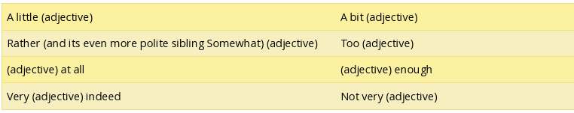
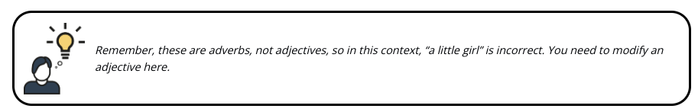
DG/P:
Información Tema 1.3
Escritorio
Diseño para actividad 03.
Dónde está la actividad 3B??
Se pueden reutilizar algunos elementos del curso anterior.
Archivo en word en Teams. Requiere formato, el esquema, pleca de la EE.
Para descarga (sr-only)
Word document (nombre del archivo) – Button.
Dispositivos
Dejar la tabla en modo vertical.
English Proficiency
EP U1 Activity 03
Connotations of modifying adverbs
Instructions
Modifying adverbs are pretty easy to spot, but look at these. How many of these can only be used with a negative connotation?
2. Look the table again and note where they are located in relation to the adjective.
3. Download the next format and answer the questions.
4. Once you finish this activity, save the file, name it EPU1_03A_FirstNameandLastName.pdf, and include it in your Unit 1 portfolio for subsequent submission.
Did you find anything new?
5. Rearrange the adverbs into the following table. Add more as you come across them. Do the activity using the following format.
6. Once you finish this activity, save the file, name it EPU1_03B_FirstNameandLastName.pdf, and include it in your Unit 1 portfolio for subsequent submission.
Texto typeado:
A little (adjecctive).
A bit (adjective).
Rather (and its even more polite sibling Somewhat) (adjective).
Too (adjective).
(Adjective) at all.
(Adjective) enough.
Very (adjective) indeed.
Not very (adjective).
Remember, these are adverbs, not adjectives, so in this context, “a little girl” is incorrect. You need to modify an adjective here.
Connotations of modifying adverbs (A)
Connotations of modifying adverbs (B)

Slide 10
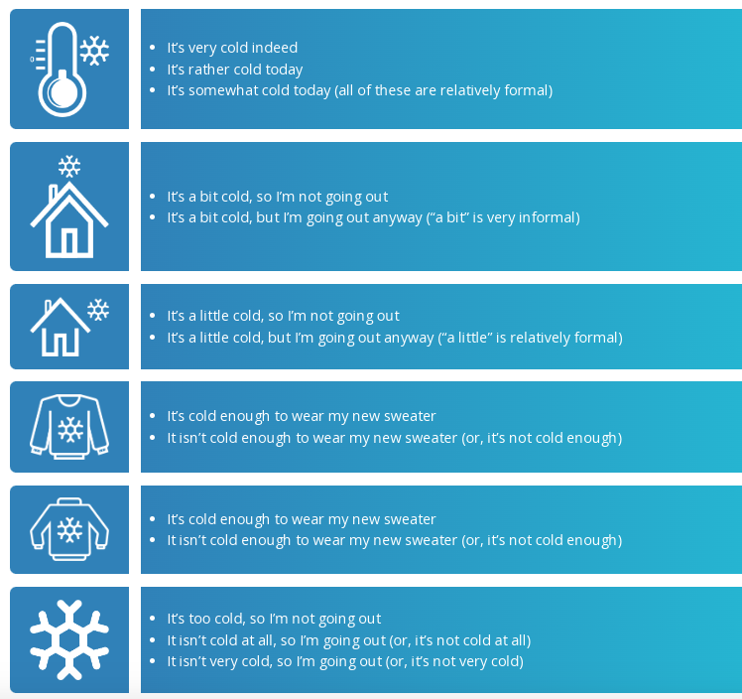
DG/P:
Información Tema 1.3
Escritorio
Se puede utilizar el diseño anterior (valorar DG).
Dispositivos
Se queda como está actualmente en dispositivos. En responsivo, la imagen se pasa arriba y el texto debajo.
English Proficiency
To reinforce your understanding, look at these “cold” sentences.
It’s very cold indeed.
It’s rather cold today.
It’s somewhat cold today (all of these are relatively formal).
It’s a bit cold, so I’m not going out.
It’s a bit cold, but I’m going out anyway (“a bit” is very informal).
It’s a little cold, so I’m not going out.
It’s a little cold, but I’m going out anyway (“a little” is relatively formal).
It’s cold enough to wear my new sweater.
It isn’t cold enough to wear my new sweater (or, it’s not cold enough).
It’s cold enough to wear my new sweater.
It isn’t cold enough to wear my new sweater (or, it’s not cold enough).
It’s too cold, so I’m not going out.
It isn’t cold at all, so I’m going out (or, it’s not cold at all).
It isn’t very cold, so I’m going out (or, it’s not very cold).

Slide 11
DG/P:
Información Tema 1.3
Escritorio
Diseño para actividad 04.
Se puede retomar el diseño del curso anterior.
Archivo en word en Teams. Requiere formato, el esquema, pleca de la EE.
Para descarga (sr-only)
Word document (nombre del archivo) – Button.
Dispositivos
Se queda igual.
English Proficiency
Note that although essentially neutral, “a bit” and “a little” are used here with a negative connotation. However, they are never used with a directly positive adjective. You can say, “it’s a bit nasty” but not “it’s a bit nice,” or “it’s a bit obvious,” but not “it’s a bit straightforward”. “Nasty” is negative, “obvious” is neutral, but “nice” and “straightforward” are positive and will need stronger modification.
EP U1 Activity 04
So and such
Instructions
Look the next sentences:
  It’s so cold today, I’m staying home.
  It’s such a cold day, I’m staying home.
  It’s so cold today that I’m staying home.
  It’s such a cold day that I’m staying home.
2. Download the next format and answer the questions.
3. Once you finish this activity, save the file, name it EPU1_04_FirstNameandLastName.pdf, and include it in your Unit 1 portfolio for subsequent submission.
So and such

Slide 12
DG/P:
Información Tema 1.4
Escritorio
Recuadro para información.
Liga: https://dictionary.cambridge.org/grammar/british-grammar/suffixes
(nombre del archivo) opens a new tab.
Se puede retomar diseño anterior.
Dispositivos
Se queda igual.
English Proficiency
HTML Outline:
English Proficiency
1.4 Grammar. Suffixies
Suffixies
  Activity 05
  Activity 06
  Activity 07
  Activity 08
  Activity 09
  Activity 10
Recording collocations
A suffix is a handy little thing that goes at the end of a word to change it into a different part of speech, for example, verb to noun, noun to adjective, adjective to adverb, or similar.
Read the next link if you want further explanation and examples: Suffixes.
1.4 Grammar. Suffixies
Stop and think
What suffixes are used in Spanish, how do they change words?
How many noun suffixes do you know in English?
Are there any parallel constructions?

Slide 13


DG/P:
Información Tema 1.4
Escritorio
Diseño para actividad 5.
Para el recurso del check:
El estudiante escribe la respuesta que considera correcta.
El check es al primer intento.
Si la respuesta es correcta la retroalimentación será: Correct! The suffixes to the word enjoy is enjoyment.
Si la respuesta es correcta la retroalimentación será: Incorrect! The suffixes to the word enjoy is enjoyment.
Archivo en word en Teams. Requiere formato, el esquema, pleca de la EE.
Para descarga (sr-only)
Word document (nombre del archivo) – Button.
Dispositivos
DG acomoda información para que sea legible en dispositivos.
La pleca roja pueden ser filas, valora DG.
PG comentar si el puntaje no es legible con DI.
El check se queda igual.
English Proficiency
EP U1 Activity 05
Noun suffixes
Instructions
1. Look at the suffixes in the box.
2. Add one of the suffixes to the word “enjoy”. Write the new word in the space provided. What does it do to that word?
3. Now complete the table using the same suffixes from the box for the words in all three columns. Some spelling changes may be necessary. Do the activity using the following format.
4. Check your answers in your dictionary.
5. Once you finish this activity, save the file, name it EPU1_05_FirstNameandLastName.pdf, and include it in your Unit 1 portfolio for subsequent submission.
Texto typeado:
ship
iety
itry
ance
hood
age
ment
ure
cy
ce
ness
ence
al
Enjoy
Noun suffixes

Slide 14
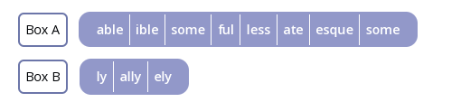
DG/P:
Información Tema 1.4
Escritorio
Diseño para actividad 06.
Se puede retomar diseño del curso anterior.
Archivo en word en Teams. Requiere formato, el esquema, pleca de la EE.
Para descarga (sr-only)
Word document (nombre del archivo) – Button.
Dispositivos
Se quita paso 1 con box A y B.
Paso 2 se vuelve 1.
Paso 3 se vuelve 2.
English Proficiency
EP U1 Activity 06
Adjective and adverb suffixes
Instructions
1. Look at these:
2. Download the file “adjective and adverb suffixes” from the button below and complete it by using the main words first as an adjective (A) and then as an adverb (B). Some words won’t be transformable into adverbs or adjectives and you’ll have to rearrange some of the lines, so you’ll need to be rather proactive here. A dictionary will be useful.
3. Once you finish this activity, save the file, name it EPU1_06_FirstNameandLastName.pdf, and include it in your Unit 1 portfolio for subsequent submission.
Texto typeado:
able
ible
some
ful
less
ate
esque
some
ly
ally
ely
Box A
Box B
Adjective and adverb suffixes

Slide 15
DG/P:
Información Tema 1.4
Escritorio
Diseño para actividad 07.
Archivo en word en Teams. Requiere formato, el esquema, pleca de la EE.
Para descarga (sr-only)
Word document (nombre del archivo) – Button.
Dispositivos
Se queda igual.
English Proficiency
EP U1 Activity 07
Making verbs with suffixes
Instructions
1. So far so good, but how do we make verbs from other words?
-en
Darken, widen, lengthen, brighten, blacken, deepen... What part of speech is used with the suffix -en, and which is the odd one out in this list? Take a close look.
2. Are all those words adjectives + -en? Start to make a new table of these verbs, and add examples when you find them. Do the activity using the following format.
3. Once you finish this activity, save the file, name it EPU1_07_FirstNameandLastName.pdf, and include it in your Unit 1 portfolio for subsequent submission.
Making verbs with suffixes

Slide 16
DG/P:
Información Tema 1.4
Escritorio
Diseño para actividad 08.
Archivo en word en Teams. Requiere formato, el esquema, pleca de la EE.
Para descarga (sr-only)
Word document (nombre del archivo) – Button.
Dispositivos
Se queda igual.
English Proficiency
EP U1 Activity 08
Suffix table
Instructions
1. Download the suffix table and write a word for every suffix plus its part of speech (noun, adjective, etc.). Check your answer in a dictionary and write brief but complete sentences for each of the words.
2. Once you finish this activity, save the file, name it EPU1_08_FirstNameandLastName.pdf, and include it in your Unit 1 portfolio for subsequent submission.
Suffix table

Slide 17
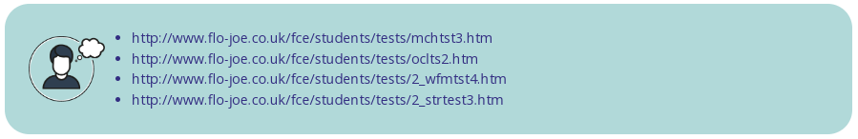
DG/P:
Información Tema 1.4
Escritorio
Diseño para actividad 09.
Se puede utilizar el diseño gráfico del recurso anterior.
Para las páginas (nombre del archivo) opens a new tab.
https://www.flo-joe.co.uk/fce/students/tests/mchtst3.htm
https://www.flo-joe.co.uk/fce/students/tests/oclts2.htm
https://www.flo-joe.co.uk/fce/students/tests/2_wfmtst4.htm
https://www.flo-joe.co.uk/fce/students/tests/2_strtest3.htm
Dispositivos
Texto plano.
English Proficiency
EP U1 Activity 09
Use of English practice
Instructions
1. Do the following tests online, check your answers and then upload your scores.
2. Once you finish, upload the screenshots of your scores this activity in one file, name it EPU1_09_FirstNameandLastName.pdf, and include it in your Unit 1 portfolio for subsequent submission.
FCE Reading and Use of English Part 1: Multiple Choice Cloze.
FCE Reading and Use of English Part 2: Open Cloze.
FCE Reading and Use of English Part 3: Word Formation.
FCE Reading and Use of English Part 4: Key Word Transformation.

Slide 18
DG/P:
Información Tema 1.4
Escritorio
Diseño para actividad 10.
Archivo en word en Teams. Requiere formato, el esquema, pleca de la EE.
Para descarga (sr-only)
Word document (nombre del archivo) – Button.
Dispositivos
1 columna y abajo la otra.
English Proficiency
EP U1 Activity 10
Collocations
Instructions
1. Can you match these adjectives with their nouns?
2. Download the following activity, match the adjective with their nouns and use each of them to make a sentence that is true for you.
3. Once you finish this activity, save the file, name it EPU1_10_FirstNameandLastName.pdf, and include it in your Unit 1 portfolio for subsequent submission.
overnight
secret
strong
dismal
daunting
failure
challenge
sucess
chance
ambition
Collocations

Slide 19
DG/P:
Información Tema 1.4
Escritorio
Diseño para recuadro con información en liga.
(nombre del archivo) opens a new tab.
https://www.freecollocation.com/
Dispositivos
Se queda igual.
English Proficiency
Recording collocations
There are so many collocations that a list of them would take up pages and pages. Instead, you can use an online dictionary to check your answers: Online Collocation Dictionary.
Now you can start to keep a list of interesting collocations in your notebook. When you find a new one, check it in the dictionary and add alternatives.
Example:
secret - burning - lifelong – ambition.

Slide 20
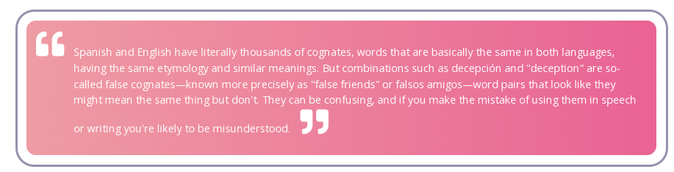
DG/P:
Información Tema 1.5
Escritorio
Se puede retomar diseño del curso anterior.
Dispositivos
Se queda igual.
English Proficiency
HTML Outline:
English proficiency
1.5 Grammar. False friends
False cognates
  Activity 11
False cognates
We all know them, the nice reliable ones we think we can always depend on... and then we discover they don’t always mean what they say:
1.5 Grammar. False friends
“Spanish and English have literally thousands of cognates, words that are basically the same in both languages, having the same etymology and similar meanings. But combinations such as decepción and "deception" are so-called false cognates—known more precisely as "false friends" or falsos amigos—word pairs that look like they might mean the same thing but don't. They can be confusing, and if you make the mistake of using them in speech or writing you're likely to be misunderstood”.
Gerald Erichsen, About.com Guide.

Slide 21
DG/P:
Información Tema 1.5
Escritorio
Diseño para actividad 11.
Archivo en word en Teams. Requiere formato, el esquema, pleca de la EE.
Para descarga (sr-only)
Word document (nombre del archivo) – Button.
Recuadro para información en liga.
(nombre del archivo) opens a new tab.
https://www.thoughtco.com/obvious-but-wrong-false-friends-3078344
Dispositivos
Se queda igual.
English Proficiency
EP U1 Activity 11
False friends
Instructions
1. Download the false friends table and write a concise sentence using the words in the list, as the part of speech given (use verbs in any form or tense you choose).
2. Once you finish this activity, save the file, name it EPU1_11_FirstNameandLastName.pdf, and include it in your Unit 1 portfolio for subsequent submission.
False friends
Now go here to check if you have the right meaning. The guide was written for learners of Spanish, so you’ll have to work backwards (which might be fun!) False Friends in Spanish and English.
Have you encountered any false friends in particular you think others should know about?

Slide 22
DG/P:
Información Tema 1.6
Escritorio
Se puede retomar el diseño del curso anterior.
Recuadro para información en liga.
(nombre del archivo) opens a new tab.
https://www.thoughtco.com/https://www.scribd.com/doc/16437825/Dependent-Prepositions
Dispositivos
Se queda igual.
English Proficiency
HTML Outline:
English proficiency
1.6 Grammar. Dependent Prepositions
  Activity 12
1.6 Grammar. Dependent prepositions
By this, I’m thinking ________ verbs like “think” that take a specific preposition that goes into that space. Do you know which one it is?
Prepositions are tricky, they change from one language to the next and the logic behind them is hard to decipher. The only way is to learn them and practice.
Example:
I’m thinking ___ joining a gym this year.
I’ve been thinking ___ it all morning.
It depends ___ whether I have enough money or not.
Can you fill in the gaps?
Now go here for information: Dependent Prepositions.

Slide 23

DG/P:
Información Tema 1.6
Escritorio
Diseño para actividad 12.
Se puede recuperar el diseño del curso anterior.
Recuadro para información en liga.
(nombre del archivo) opens a new tab.
https://www.englishlab.net/hp/quiz7_dependent_prepositions_1.htm
https://www.englishlab.net/hp/quiz8_dependent_prepositions_2.htm
https://www.learn4good.com/languages/evrd_grammar/adjectives_prepos.htm
https://www.liveworksheets.com/worksheets/en/English_as_a_Second_Language_(ESL)/Grammar/Dependent_Prepositions_of191294nm
Dispositivos
Se queda igual.
English Proficiency
EP U1 Activity 12
Dependent prepositions
Instructions
Now go to these sites for more examples and practice with dependent prepositions.
2. Once you finish, upload the screenshots of your scoresthis activity in one file, name it EPU1_12_FirstNameandLastName.pdf, and include it in your Unit 1 portfolio for subsequent submission.
Quiz VII. Dependent Prepositions & Prepositional Expressions 1.
Quiz VIII. Dependent Prepositions & Prepositional Expressions 2.
Preposition with Adjective Examples - use, rules & test exercise.
Dependent Prepositions.

Slide 24
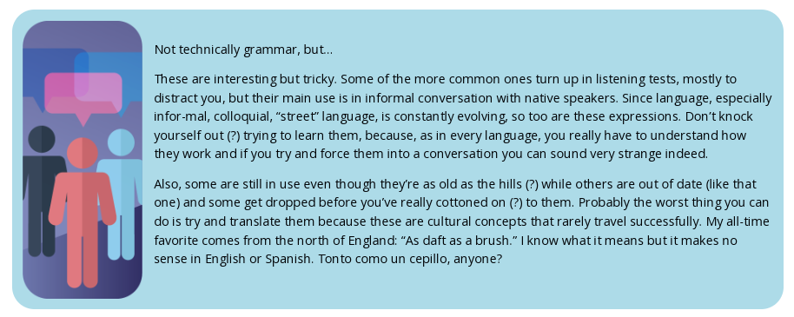
DG/P:
Información Tema 1.7
Escritorio
Recuadro para información en liga.
(nombre del archivo) opens a new tab.
http://www.englishpage.com/gerunds/index.htm
Se puede retomar parte del diseño del curso anterior.
Dispositivos
Imagen superior.
English Proficiency
HTML Outline:
English proficiency
1.7 Grammar. Gerund or Infinitive?
  Activity 13
1.7 Grammar. Gerund or infinitive?
As with prepositions the grammar constructions featuring gerunds and infinitives need to be learned rather than deduced.
Example:
I like doing...
I would like to do...
I enjoy doing...
I need to do...
Those are easy, but try to think of as many examples as you can, check in with your peers.
Go to this site for more information: Gerunds and Infinitives.
A little extra - Idioms, slang, colloquial expressions and all that jazz...
Not technically grammar, but...
These are interesting but tricky. Some of the more common ones turn up in listening tests, mostly to distract you, but their main use is in informal conversation with native speakers. Since language, especially informal, colloquial, “street” language, is constantly evolving, so too are these expressions. Don’t knock yourself out (?) trying to learn them, because, as in every language, you really have to understand how they work and if you try and force them into a conversation you can sound very strange indeed.
Also, some are still in use even though they’re as old as the hills (?) while others are out of date (like that one) and some get dropped before you’ve really cottoned on (?) to them. Probably the worst thing you can do is try and translate them because these are cultural concepts that rarely travel successfully. My all-time favorite comes from the north of England: “As daft as a brush.” I know what it means but it makes no sense in English or Spanish. Tonto como un cepillo, anyone?

Slide 25
DG/P:
Información Tema 1.7
Escritorio
Archivo en word en Teams. Requiere formato, el esquema, pleca de la EE.
Para descarga (sr-only)
Word document (nombre del archivo) – Button.
Recuadro para información en liga.
(nombre del archivo) opens a new tab.
https://www.theidioms.com/
https://idioms.thefreedictionary.com/
https://www.usingenglish.com/reference/idioms/
Dispositivos
Se queda igual.
English Proficiency
EP U1 Activity 13
Idioms
Instructions
1. Download the activity and match the expressions to their meanings.
2. Once you finish this activity, save the file, name it EPU1_13_FirstNameandLastName.pdf, and include it in your Unit 1 portfolio for subsequent submission.
Idioms
Check these sites for more examples:
Idioms.
Idioms and phrases.
List of idioms by topic.

